Slide 1
Bankruptcy Prevention
P205

Slide 2
Team members:
Mr. Tittu A
Miss. Dayana Singh
Mr. Vijayakumar Reddy
Ms. Jayashri Bhivaji Gurule
Ms. Sakshi Modi
Sachin Dnyaneshwar Kanhurkar
Ms. Sejal Singh

Slide 3
Business Objective:
The goal of this particular project is to check if a business goes bankrupt from different features like industrial risk, management risk, financial flexibility, credibility, competitiveness and operating risk and prevent bankruptcy.

Slide 4
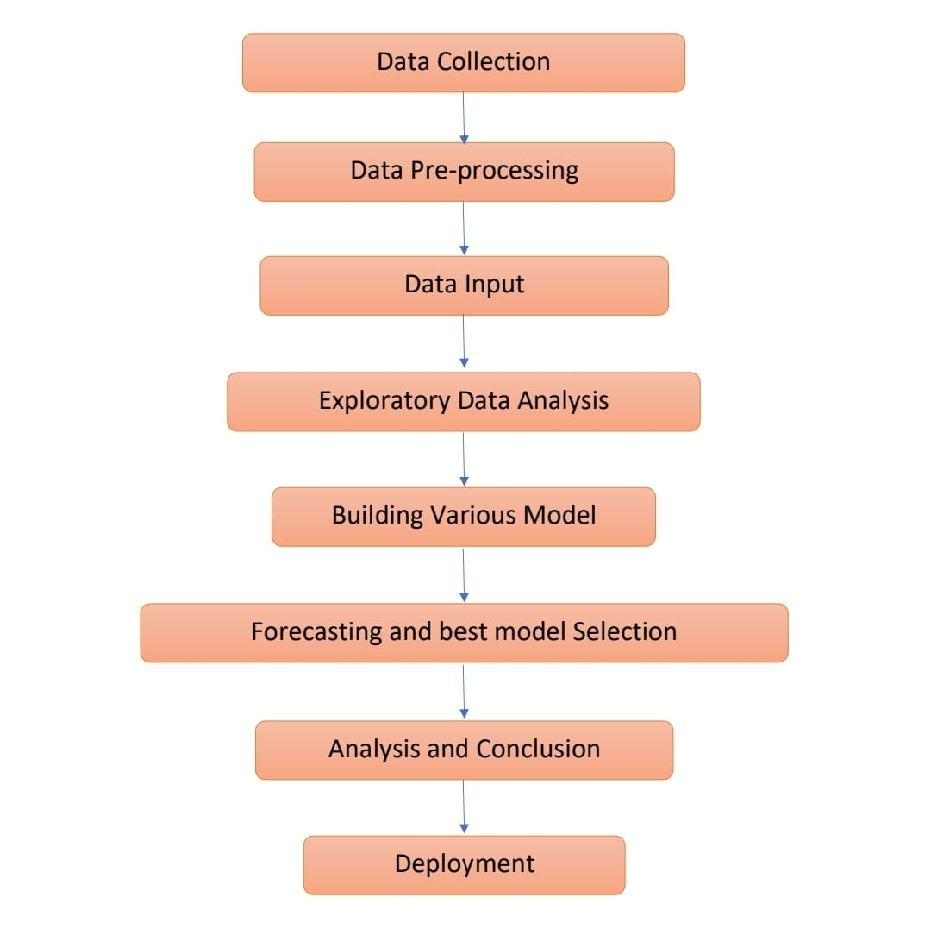
Project Workflow:

Slide 5
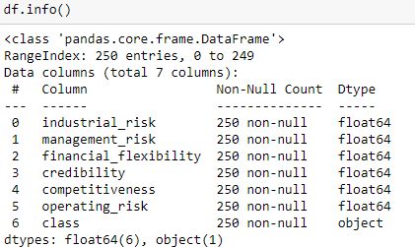
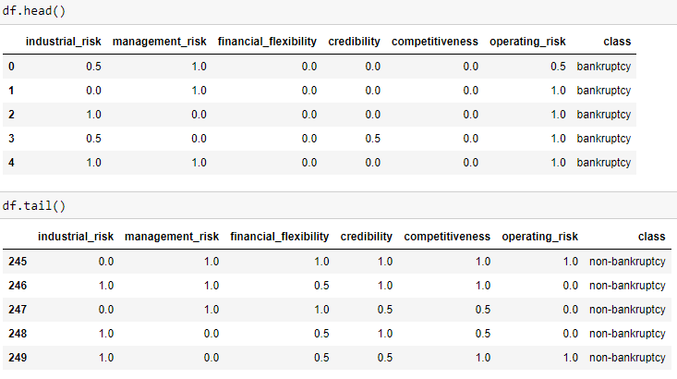
Data Set details:
The data set contains no null values.
There are 250 rows and 7 columns
The first 6 columns are float type and the class column is object type.
There are 3 categorical value in the first 6 columns : 0=low risk, 0.5=medium risk, 1=high risk.
And the class is either bankruptcy or non-bankruptcy.

Slide 6
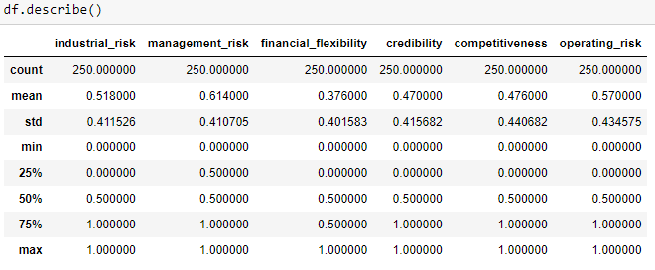
Here we found the count, mean, std, min, max of each column using df.describe() function

Slide 7
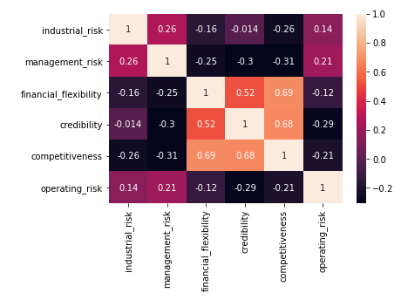
Heatmap:
This is the heatmap representation of the data to find correlation of the columns with each other.

Slide 8

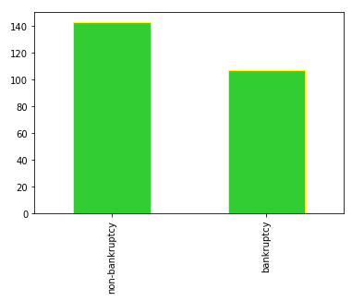
Graphical representation of the binary object column.
There are 143 non-bankruptcy and 107 bankruptcy case.

Slide 14
Thank You 2

